Slide 1
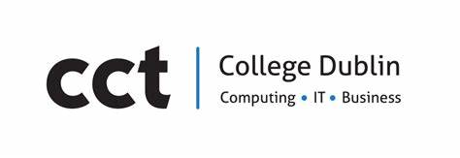
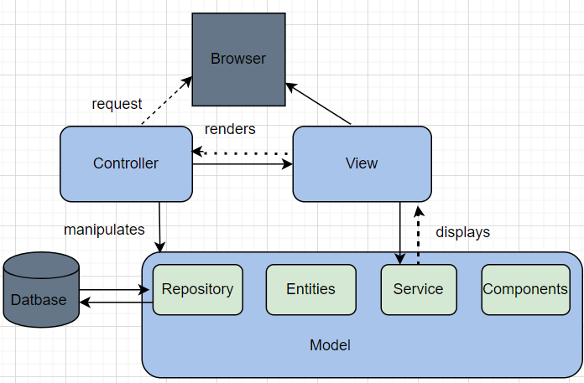
In today's digital age, businesses like "Festivals R Us", a ticket sales system, must provide a seamless and safe user experience across many platforms. With a variety of device types accessible, such as desktops, laptops, smartphones, tablets, and smartwatches, it is critical that users can connect with the application effortlessly and securely. These devices act as major touchpoints for users to view events, order tickets, and make payments. To protect sensitive information, strong security methods such as encryption, authentication, and secure payment processing are essential for ensuring consumer safety and trust across all devices.
Spring is a popular Java open-source framework for building scalable, secure, and high-performance enterprise applications. It supports multiple modules, including Spring Boot for microservices, Spring Security for authentication and authorisation, and Spring Data for database management.
Spring is a popular Java open-source framework for building scalable, secure, and high-performance enterprise applications. It supports multiple modules, including Spring Boot for microservices, Spring Security for authentication and authorisation, and Spring Data for database management.
Enterprise Software Frameworks for Festival R Us
Introduction
Results:
Ethical and legal obligations
Businesses like Festivals R Us, a ticket sales system, must provide a seamless and secure user experience. Users should be able to access the system using different types of devices. The user should connect with the application effortlessly and securely across all devices. The devices serve as a key point for the user to view events, order tickets, and make payments. Security methods such as encryption, authentication, and secure payment processing must be implemented.
Architecture and scalability:
It uses microservices architecture that allows services like payments, events listing, and ticket inventory to run independently.
It ensures high performance and uptime by scaling individual services based on demand.
Security and Data Handling:
It supports the use of spring security, OAuth2, HTTPS, and JWT.
It enables secure payment handling and user authentication and is critical for GDPR compliance.
Cross-Device Compatibility:
RESTful APIs seamless integration with web apps, mobile Apps, and kiosk and POS system
Cloud Ready:
Works well in cloud platforms (AWS, Azure).
Supports containerisation like Docker and Kubernetes
GDPR Compliance
All data from the user must be stored securely and processed with consent.
Must provide opt-in/opt-out mechanisms and support data erasure requests.
Ethical Payment Processing.
The use of PCI-DSS compliance gateways is mandatory.
Data encryption in transit and at rest must be enforced
Accessibility and Fair Use.
UI/UX must support accessibility standards.
The algorithm used for ticket allocation must be transparent and non-discriminatory.
Security by design
Regular penetration testing and audit logging
A secure development lifecycle must be followed.
Methods:
Spring Framework:
Robust with spring security, integrates with OAuth2, JWT
Highly scalable; mostly used in distributed systems
Rest APIs allow multiple device integration.
Big ecosystem, enterprise-ready, and excellent community.
Django framework
Built-in protection against SQL, CSRF injection, and XSS
Suitable for mid-sized application
The REST framework supports APIs across devices.
rapid development, batteries included, readable syntax
Not suitable for enterprise-grade applications.
.NET Core:
It has enterprise-grade security features, including identity and role-based authentication.
Highly scalable and optimized for cloud-based deployment.
Web API and Blazor support multiple devices.
Has strong performance and support from Microsoft.
Conclusion:
The Spring framework's Microservices Architecture and MVC model are suitable for the "Festivals R Us" ticket sales application. It ensures scalability, security, flexibility, and availability, which are critical for high-volume transactions. By complying with GDPR and PCI DSS, the platform will protect user privacy, meet regulatory obligations, and maintain consumer trust while providing a secure, efficient user experience across multiple devices.
References
Reference text size 15pt Arial and exactly 22pt space between lines
Fig. 1 shows how MVC works and Architecture
Mapping Processes
User Sign-Up/Login: Auth through OAuth2-JWT issued -Session initialized.
Event Listing: Frontend request event data through REST- Microservices fetches and returns the data.
Ticket Purchase: Secure payment microservice invoked - Payment confirmed - Ticket generated.
Admin Interface: Secure backend interface with RBAC for event organisers
Recommendations
For “Festival R Us,” Spring framework Architecture is recommended according to (“Introduction to Spring Framework: Java Enterprise Development” 2019 ) as it uses a modular approach, and it allows the components to be integrated and configured.
¹ Name: Caroline Iheanacho 2022503

